Slide 1
LEATSS 2015
90 Years of Summer School

Slide 2
Anthony Cornish 1935 - 2005
Summer School Leader
and Course Director
1970s - 1995
Deputy Chairman, British Theatre Association

Slide 3
Geoffrey Whitworth 1883 - 1951

Slide 4
Geoffrey Whitworth & The British Drama League
Geoffrey Whitworth (1883-1951), the son of a barrister, read modern history at Oxford and worked for the Burlington Magazine before joining the publishers Chatto and Windus. In 1919 he formed the British Drama League 'to assist the development of the arts of the Theatre and to promote a right relationship between Drama and the life of the Community'. He was awarded the CBE in 1947. He relinquished the directorship of the League in the following year to become Chairman of the British Drama League's Council. As Hon. Secretary of the Shakespeare Memorial National Theatre Committee from 1930-1951, Geoffrey Whitworth fought tirelessly for the establishment of a National Theatre.
This portrait was given to the sitter at the Royal Society of Arts in November 1934. It was presented by George Bernard Shaw, who praised Whitworth as 'one of the most important people in the theatre today'.

Slide 5
Margaret Macnamara
The work of Margaret Macnamara first became of significance in 1908, when her play The Gates of the Morning was performed by the Incorporated Stage Society at the Shaftesbury Theatre, with the backing of George Bernard Shaw. Throughout her career she wrote a number of plays which were most popular with amateur groups, such as schools, youth groups. Indeed, some of her plays written during the 1920’s were done in conjunction with Henfield Women’s Institute and their drama group, the Tip-teerers. In 1921 she became a member of the Community Theatre Committee of British Drama League and in 1926 became its Secretary. In the early 1930’s she became Honorary Research Secretary for the London Old Vic, supporting the work of Tyrone Guthrie – attending rehearsals, advising on textual obscurities and writing programme notes,

Slide 6
1925 – A letter from Margaret Macnamara

Slide 9
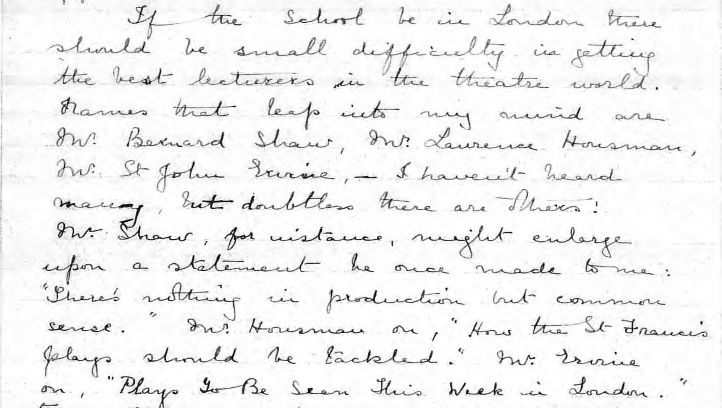

Slide 11
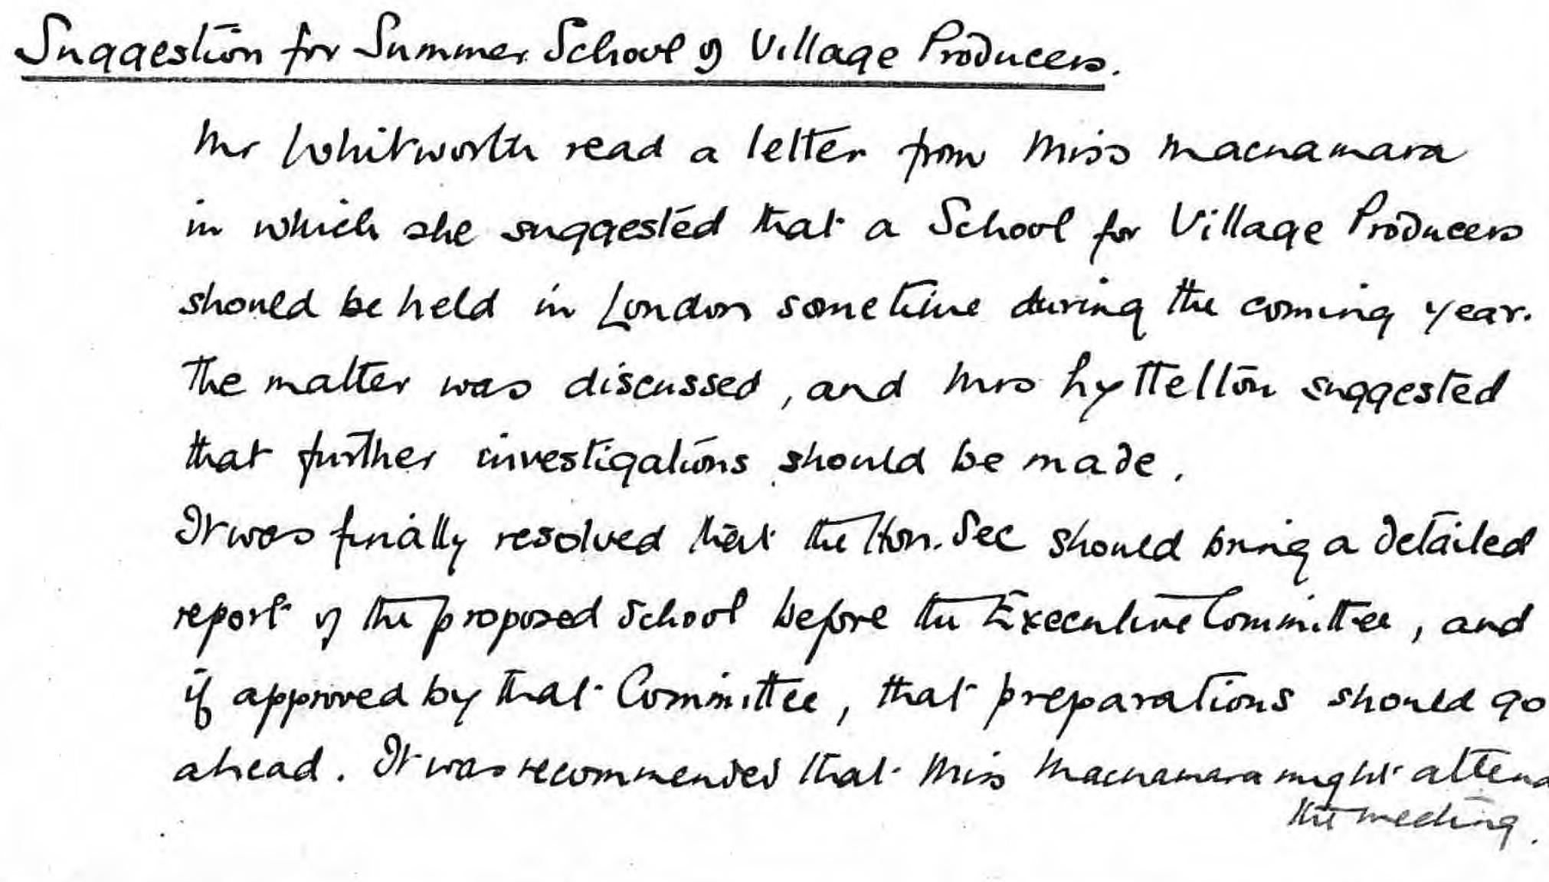

Slide 12
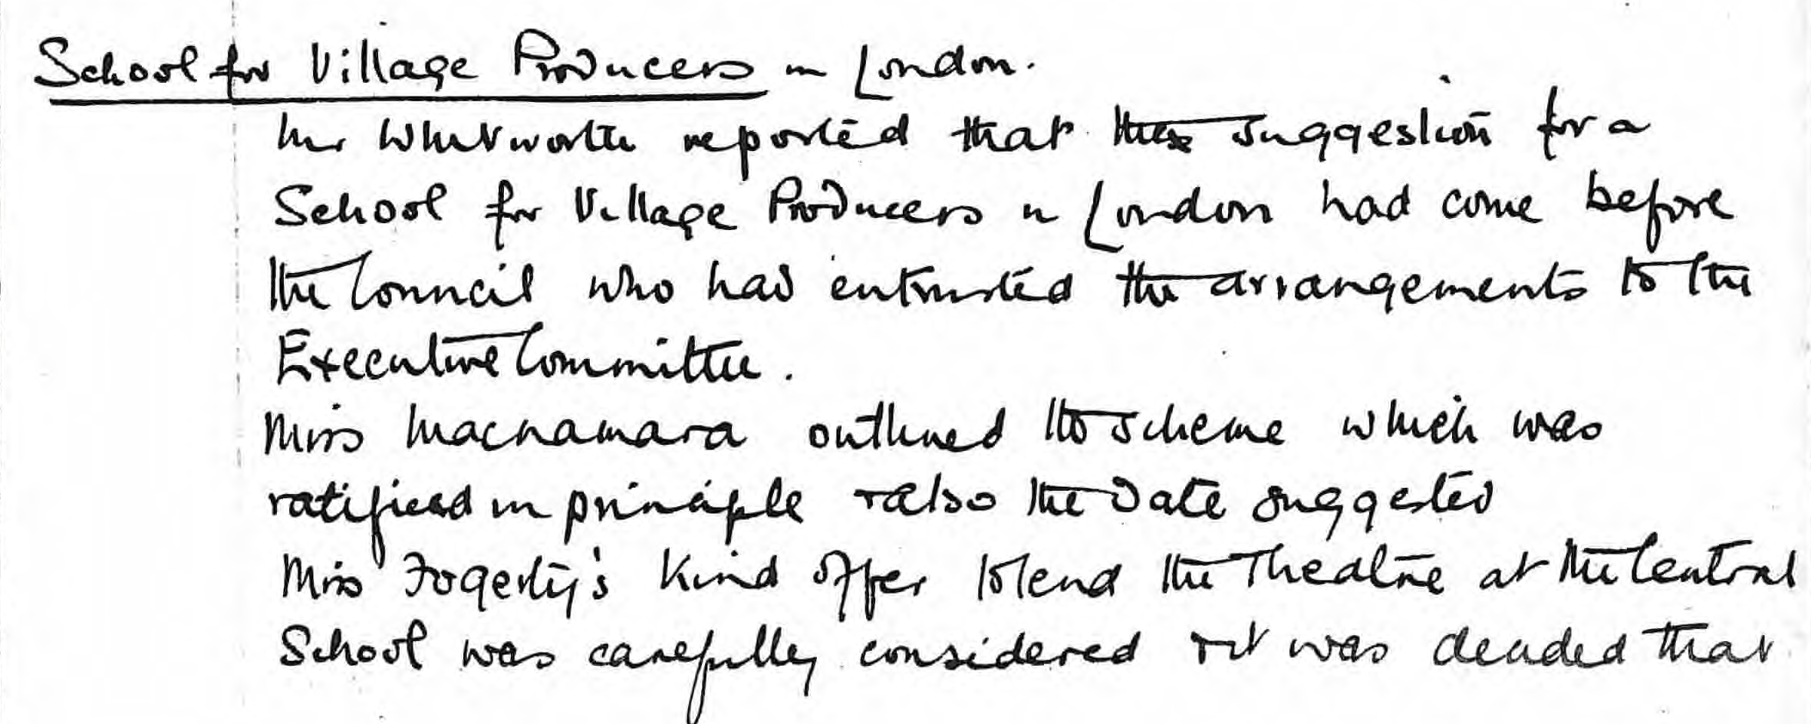
Executive Committee Nov 1925

Slide 14
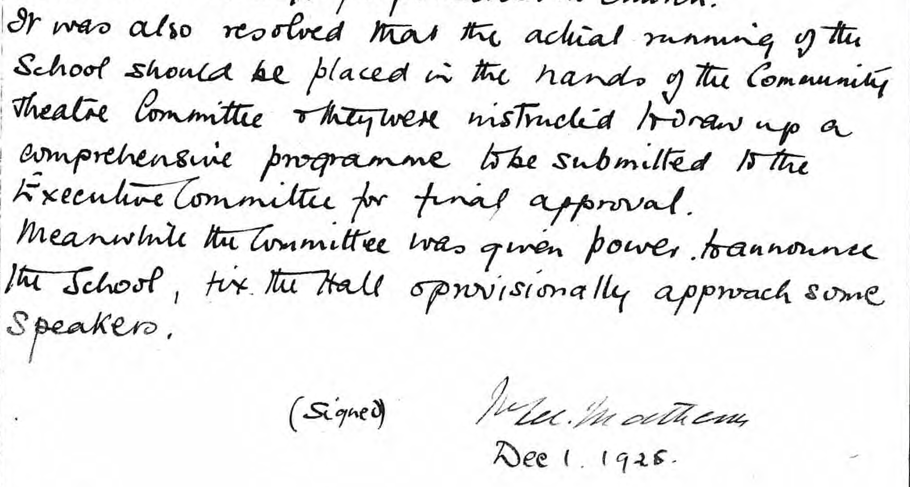

Slide 15
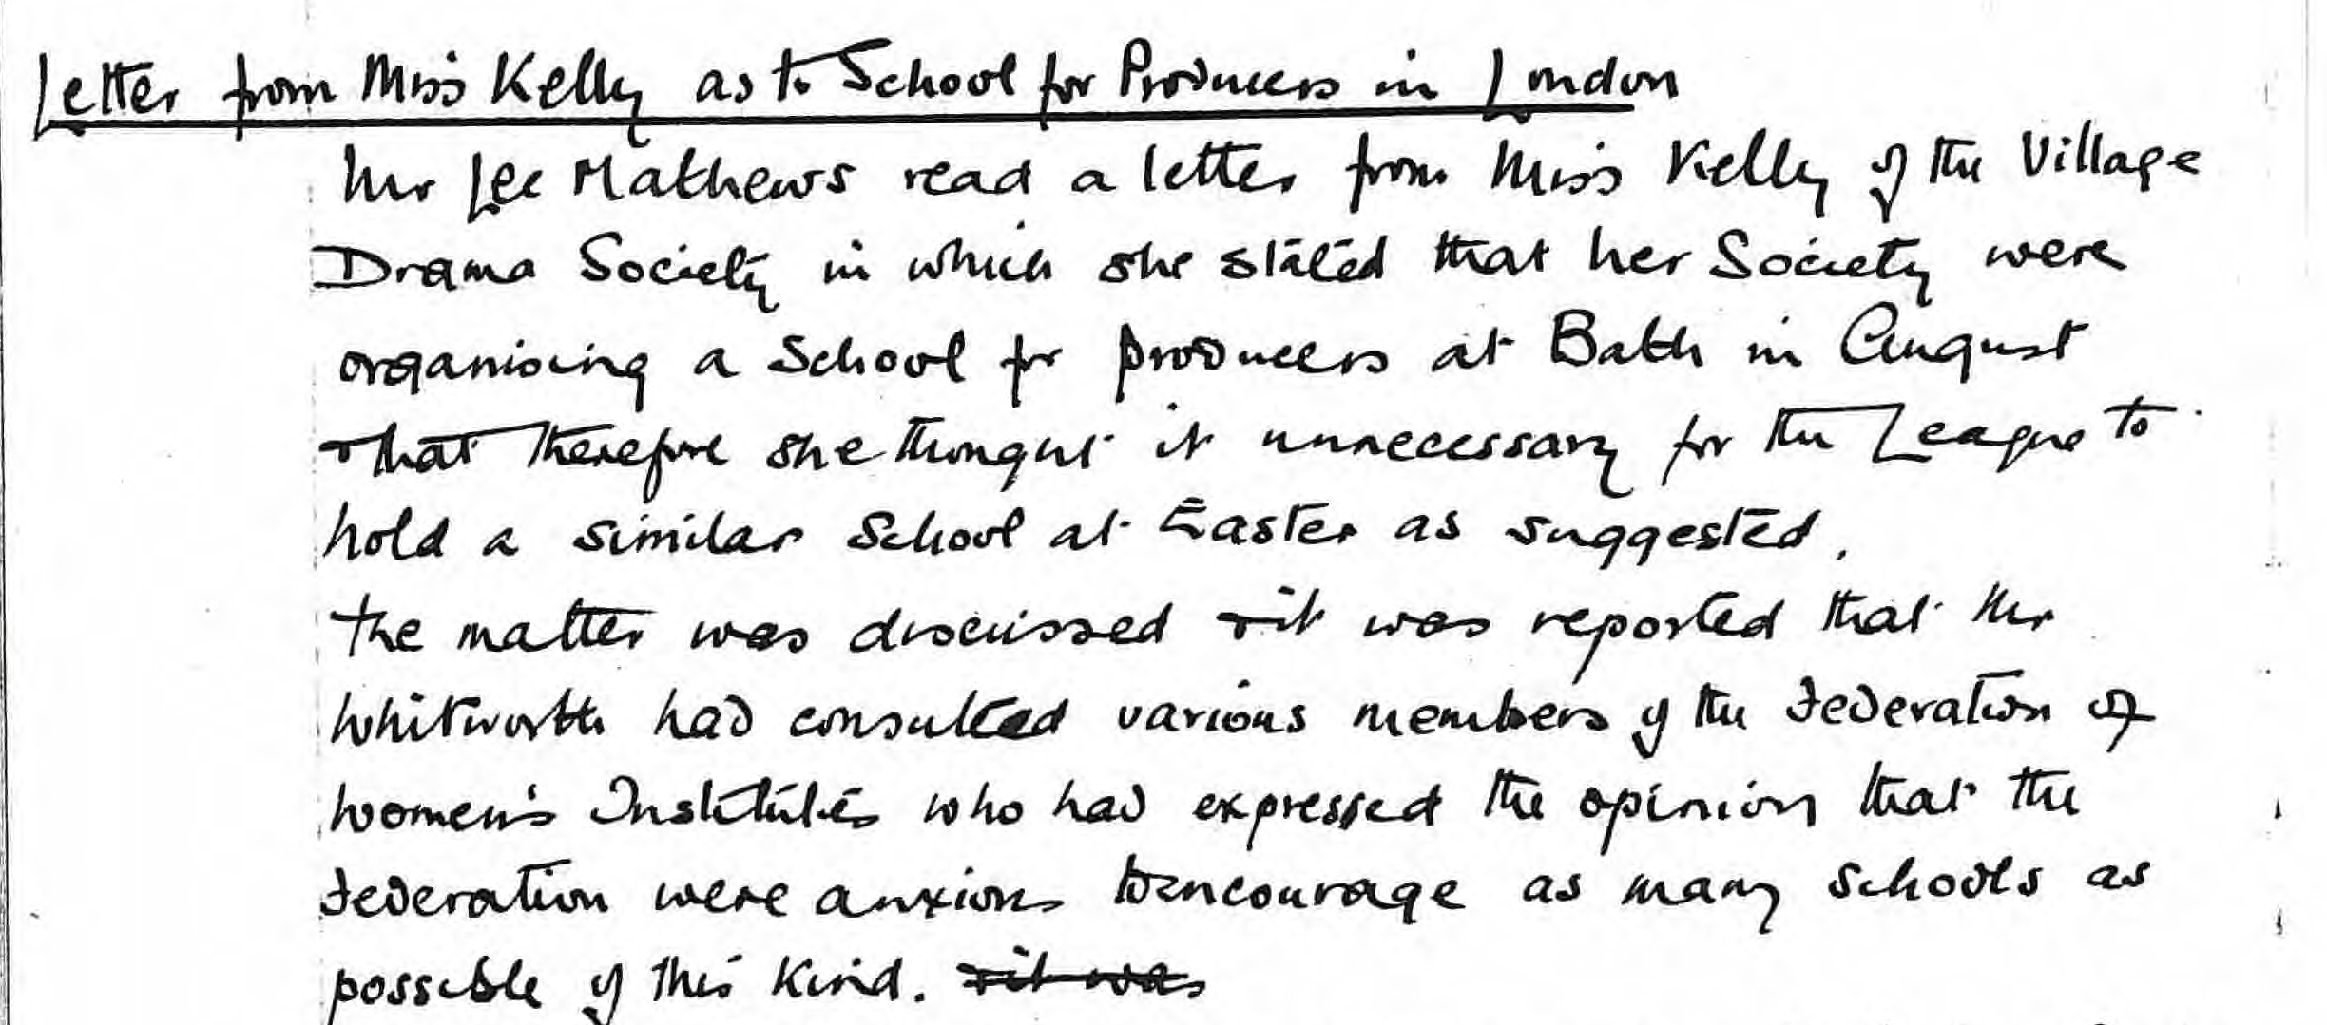
A Problem? Dec 1925

Slide 17
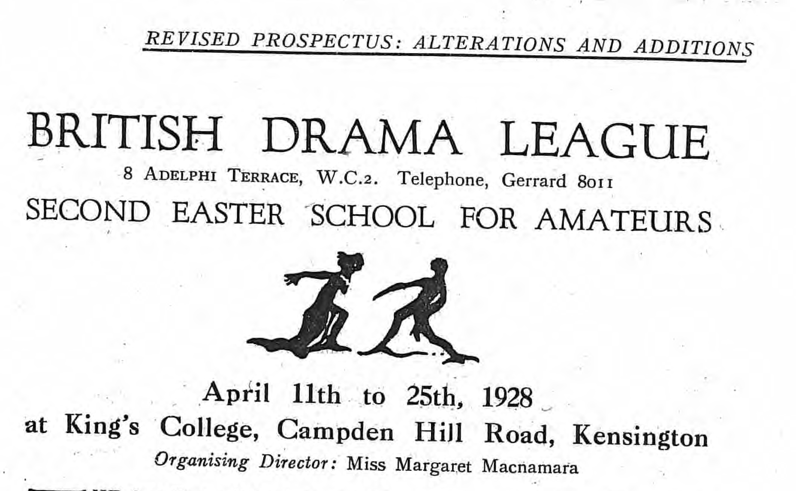

Slide 19
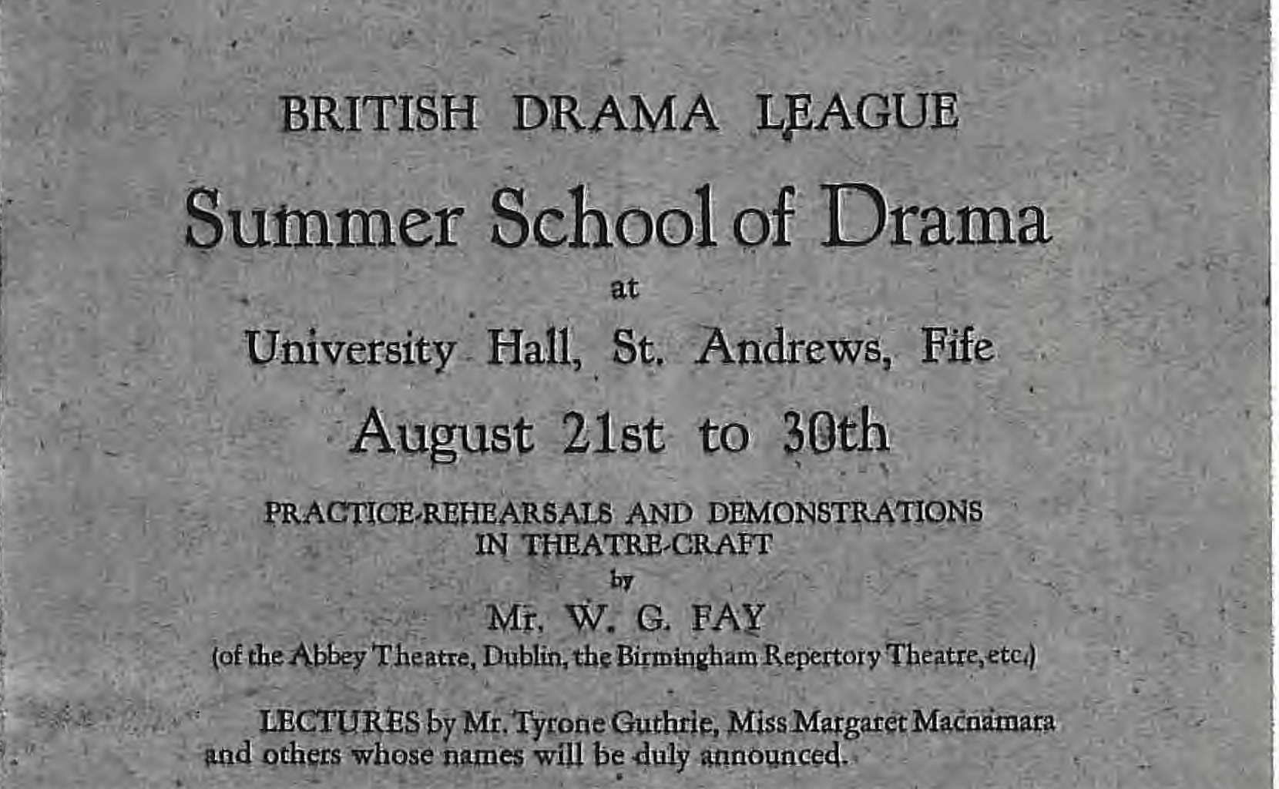

Slide 20
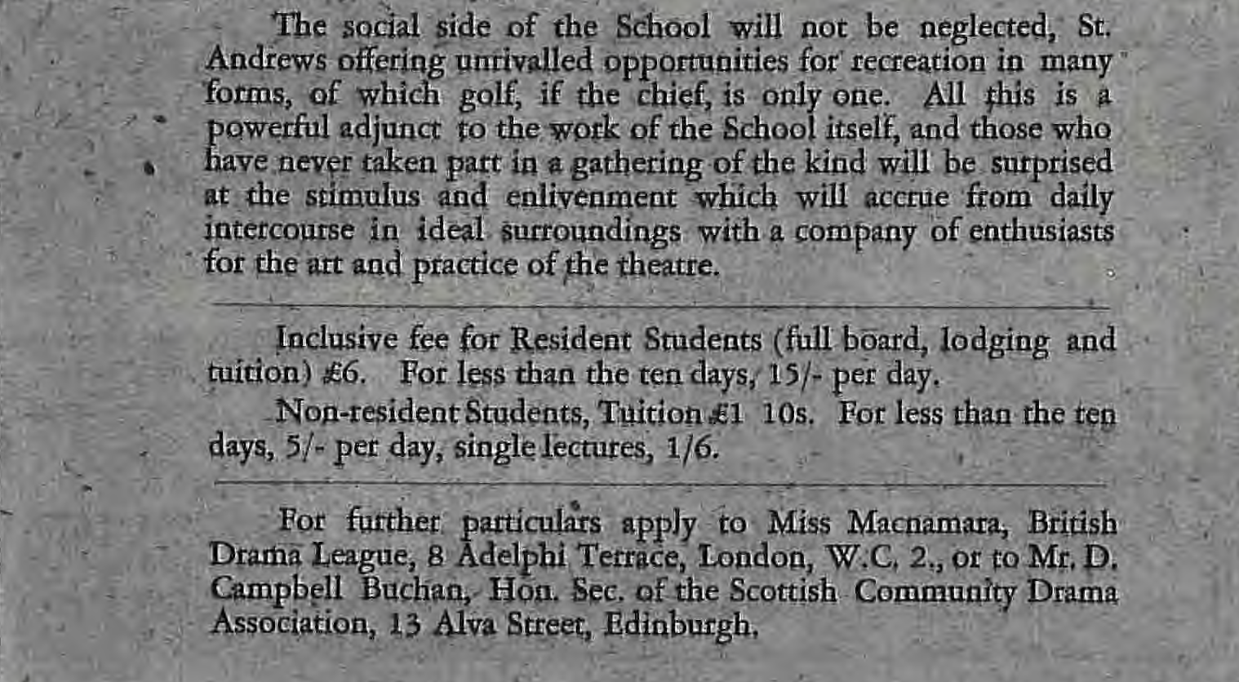

Slide 21
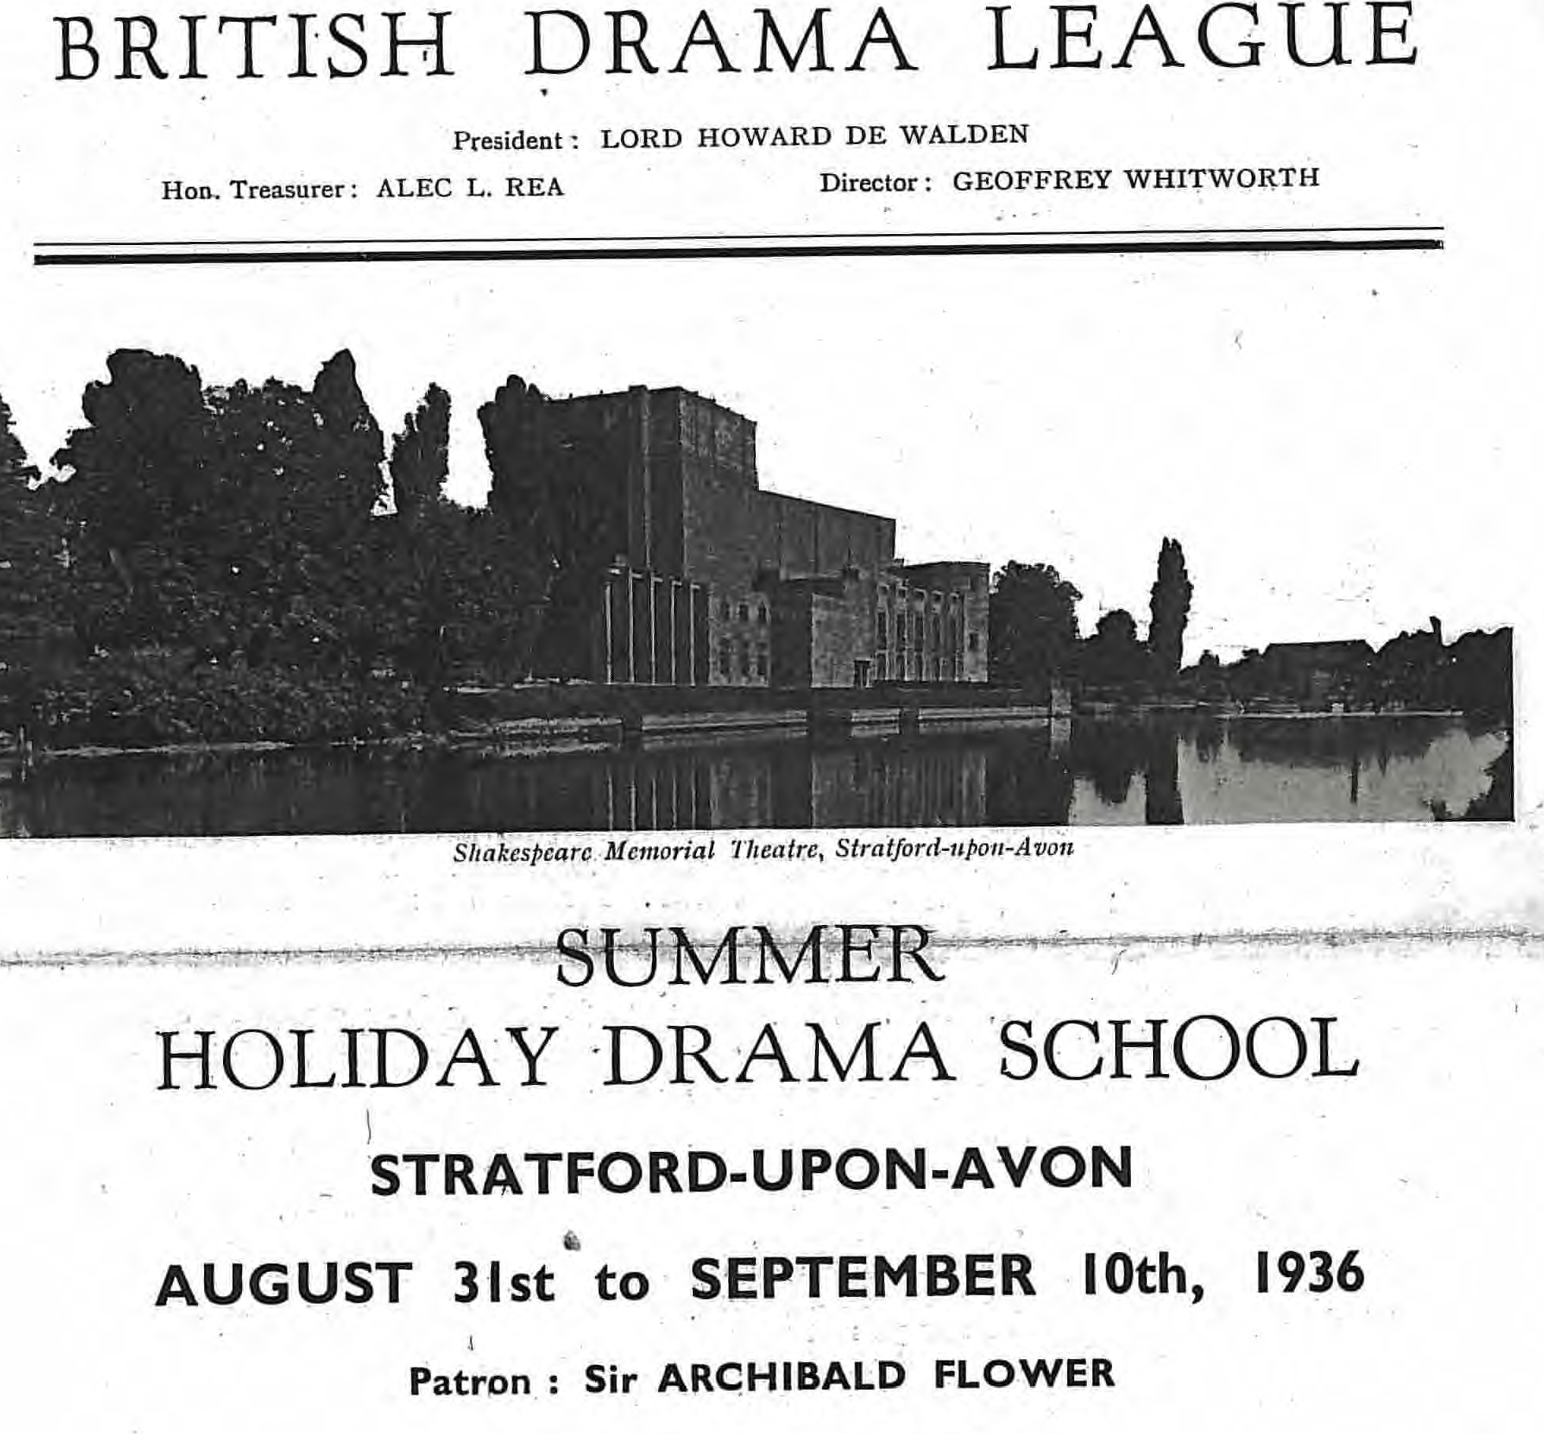

Slide 23
Frances Mackenzie BDL Head of Training 1939 - 1962

Slide 24
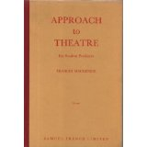
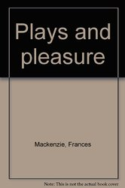
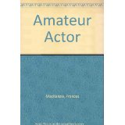

Slide 25
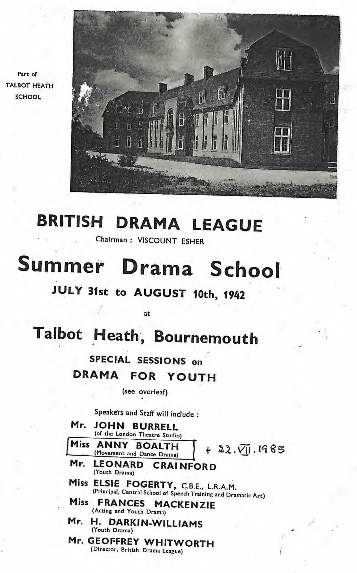

Slide 26
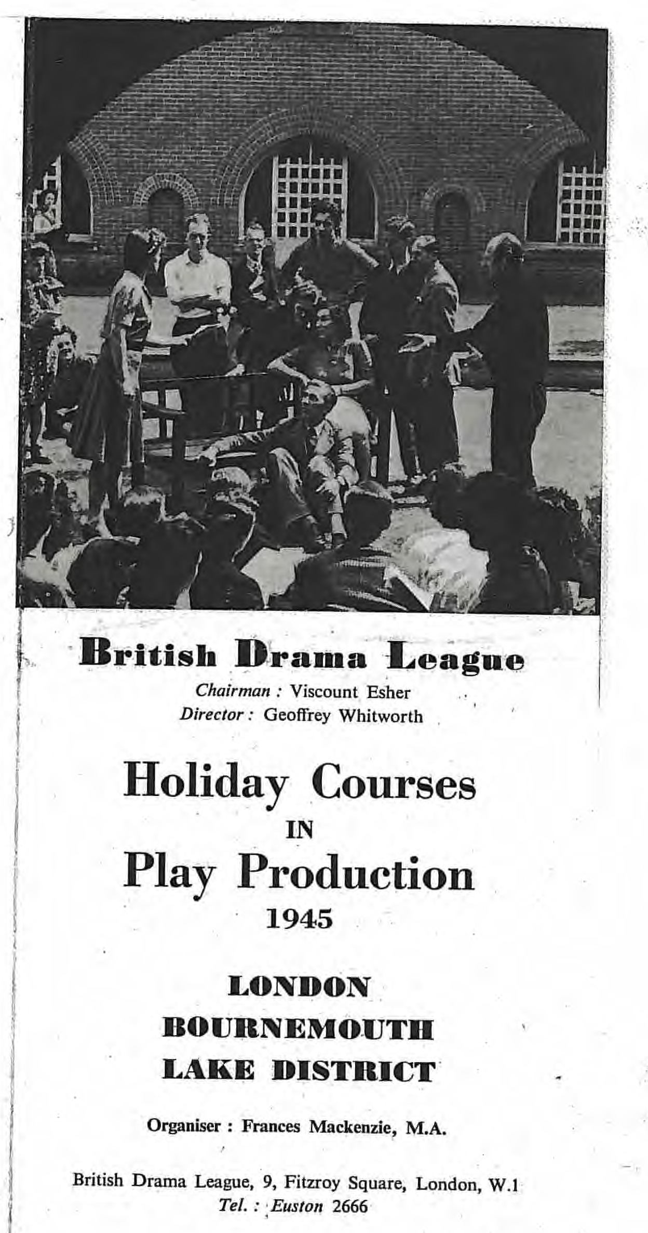

Slide 27
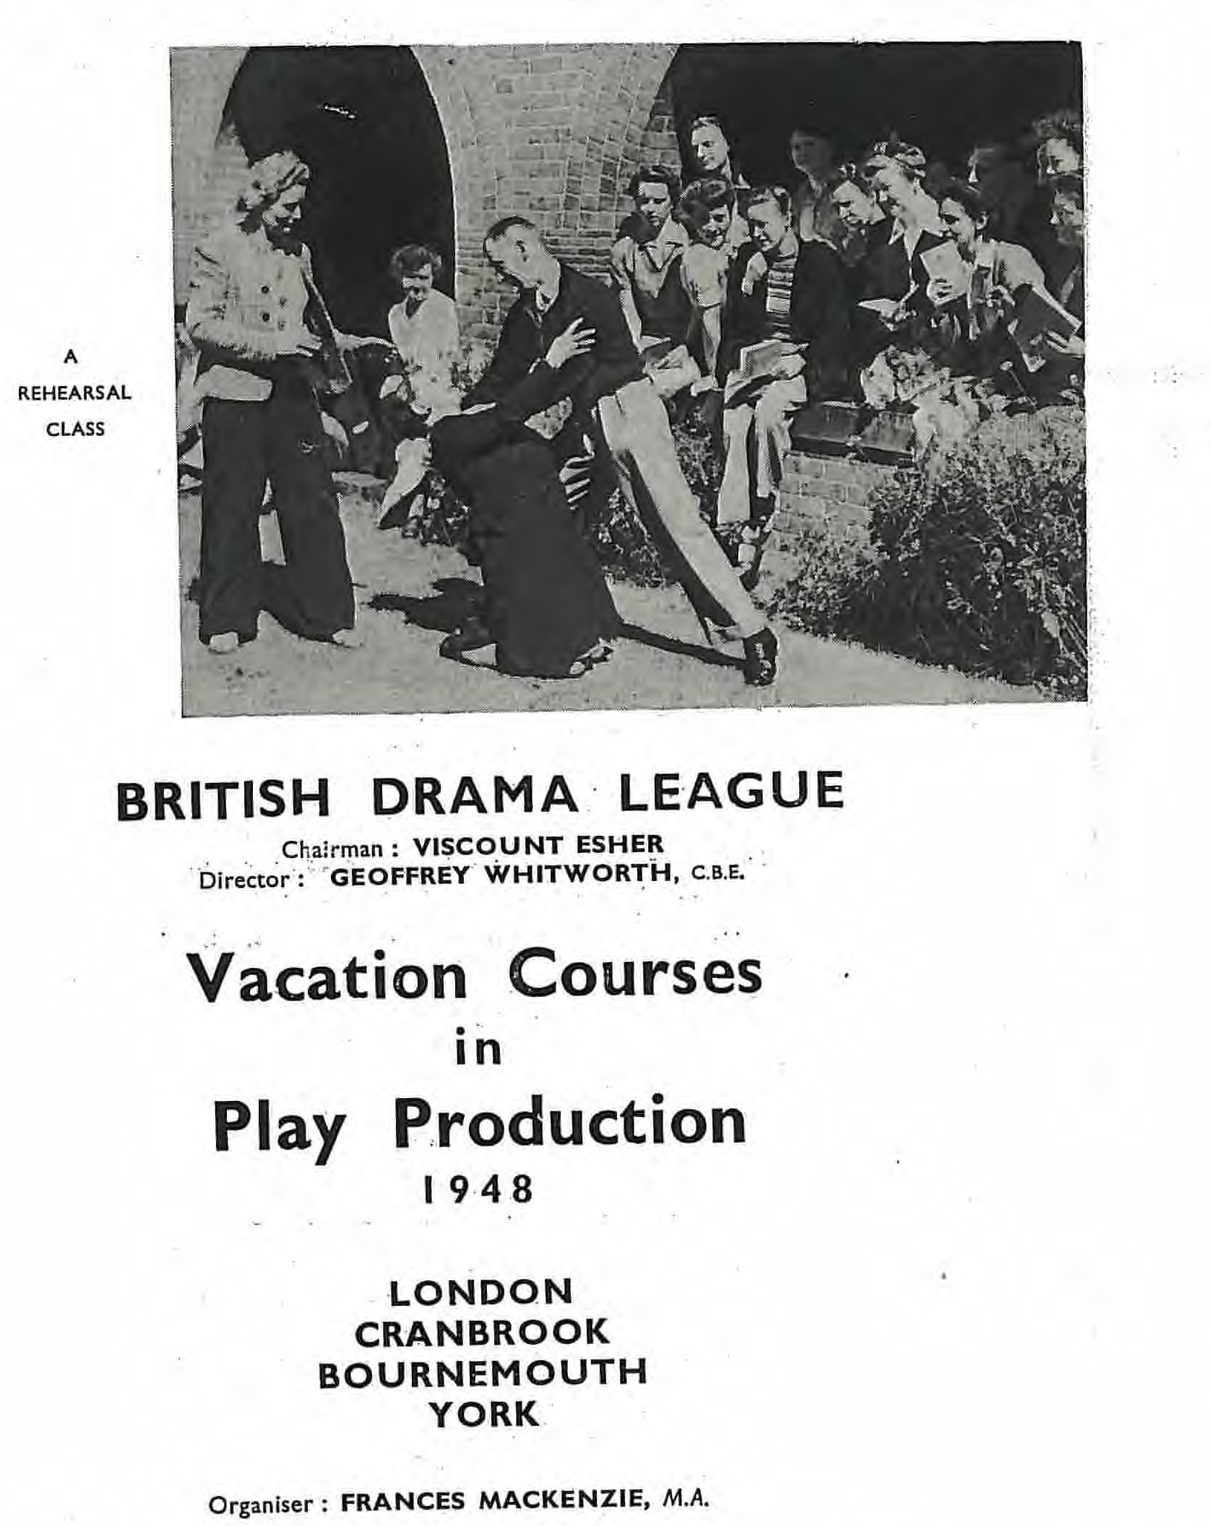

Slide 28
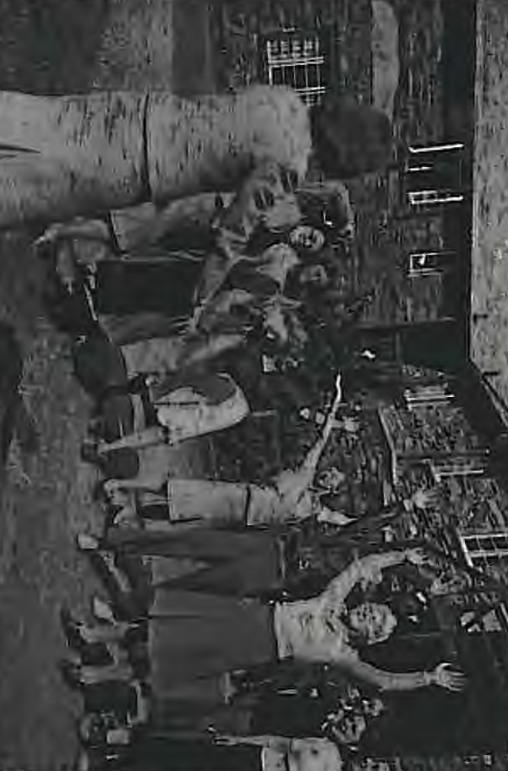
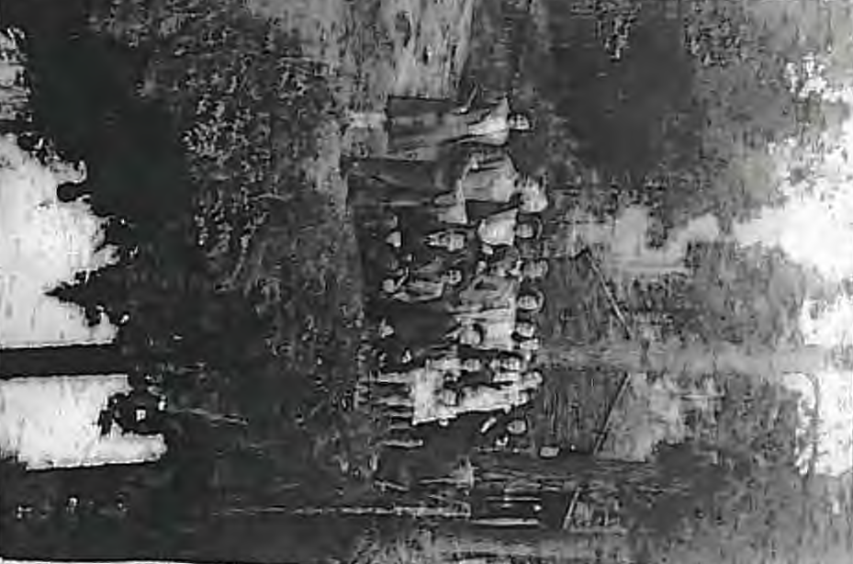
Langdale 1944

Slide 29
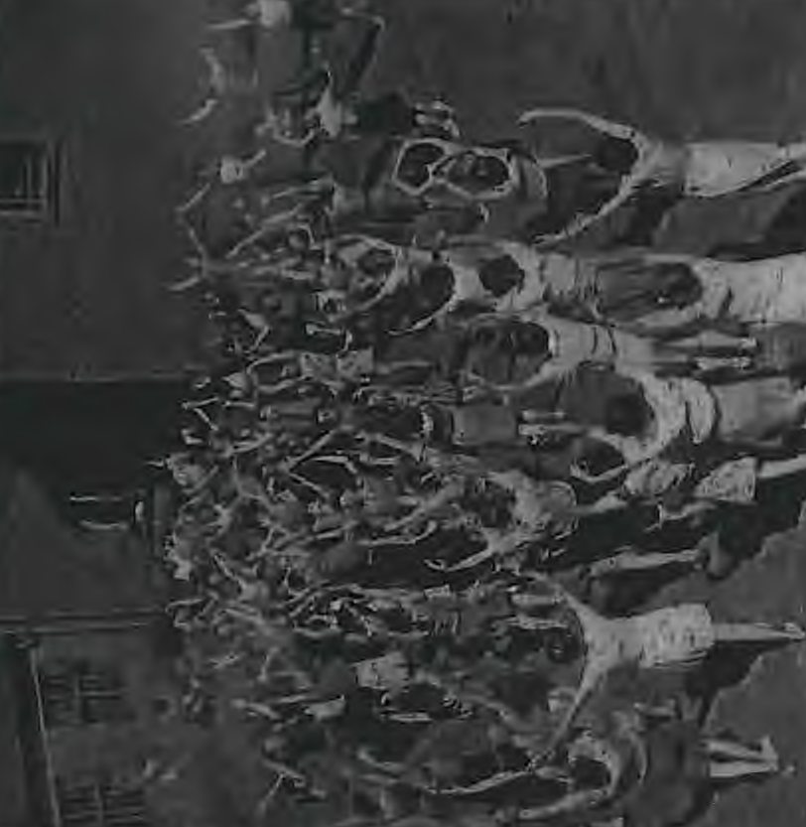
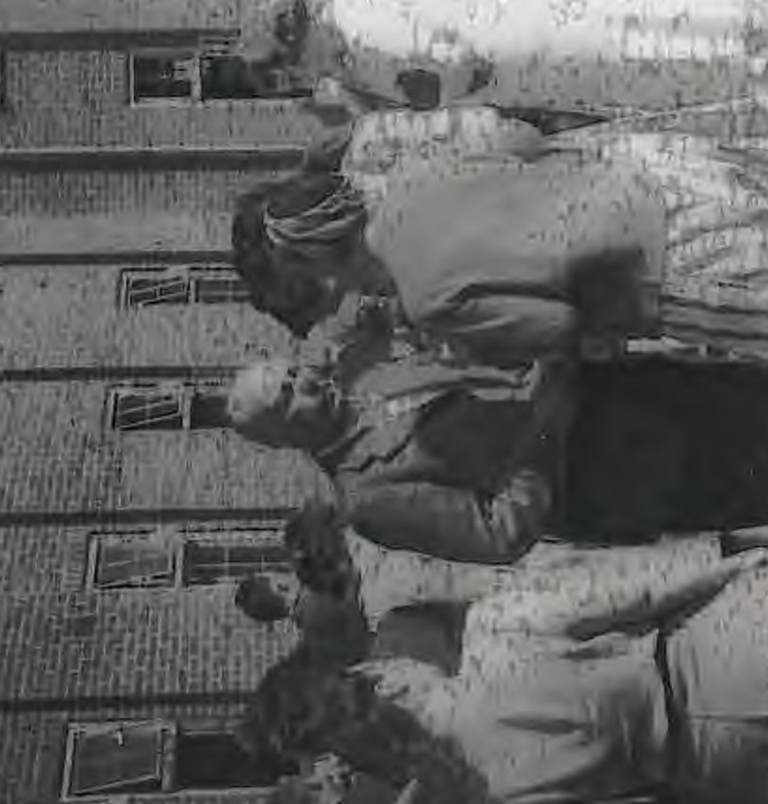
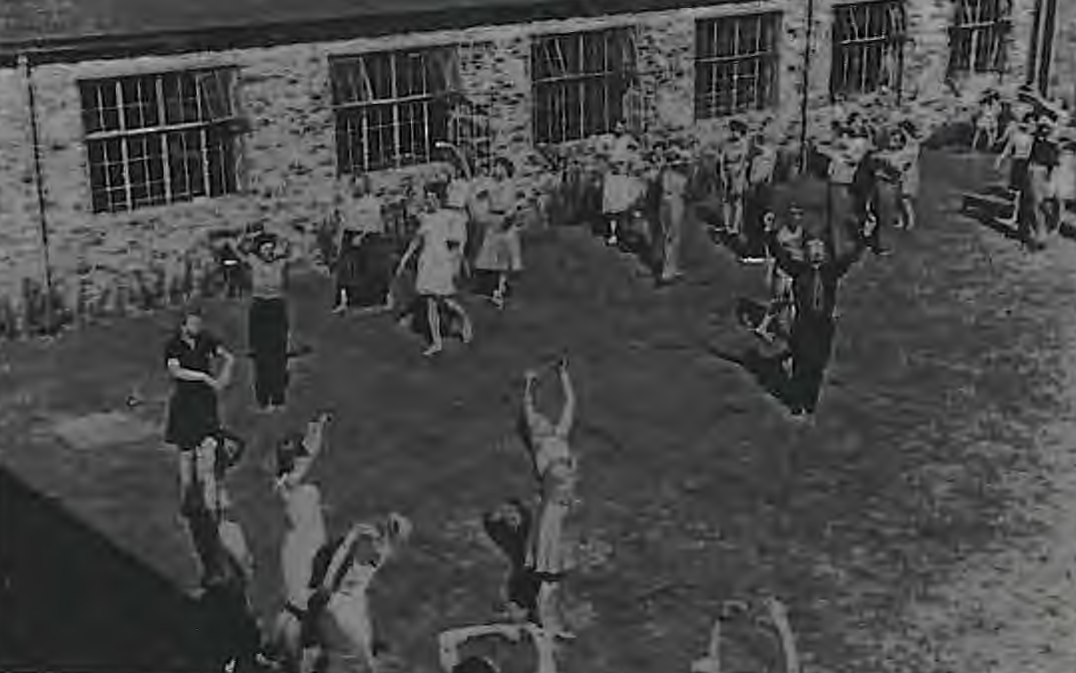

Slide 30
Rudolf Laban (1879-1958) was born in Austro-Hungary. Laban was a dancer, a choreographer and a dance / movement theoretician. One of the founders of European Modern Dance, his work was extended through his most celebrated collaborators, Mary Wigman, Kurt Jooss and Sigurd Leeder. Through his work, Laban raised the status of dance as an art form, and his explorations into the theory and practice of dance and movement transformed the nature of dance scholarship.

Slide 31
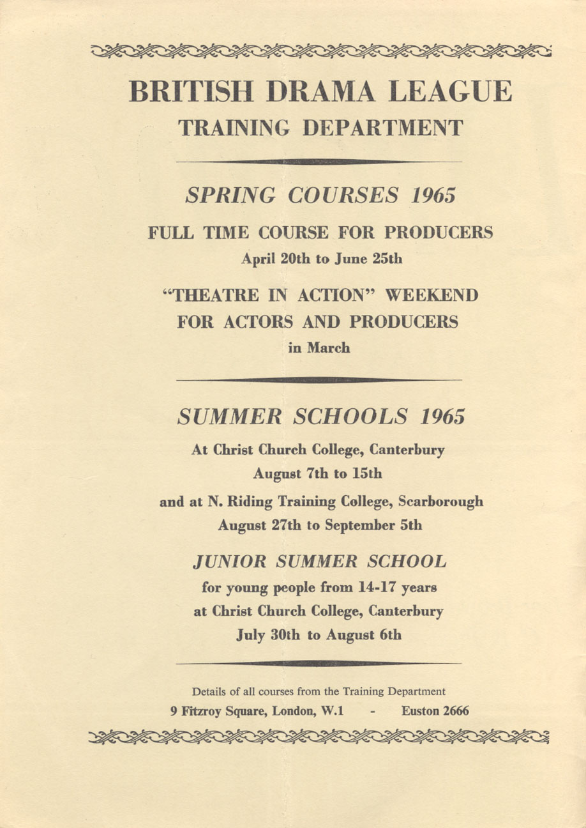

Slide 32
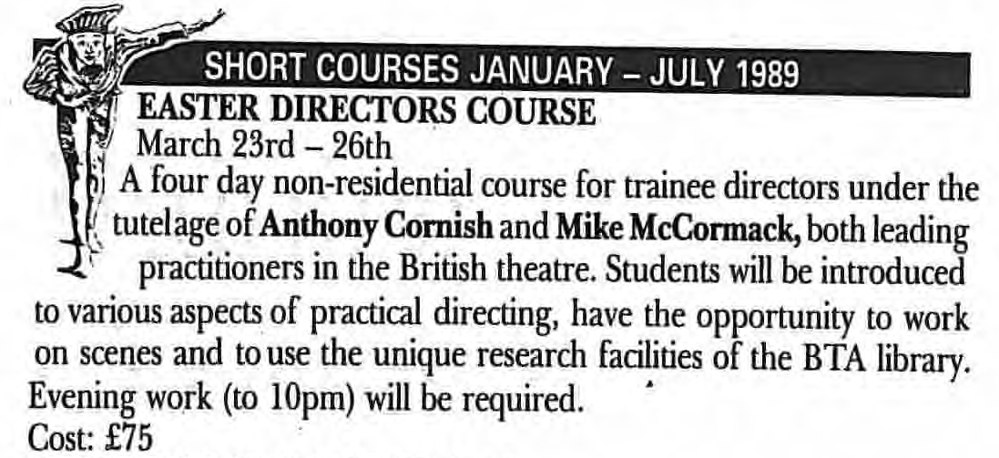
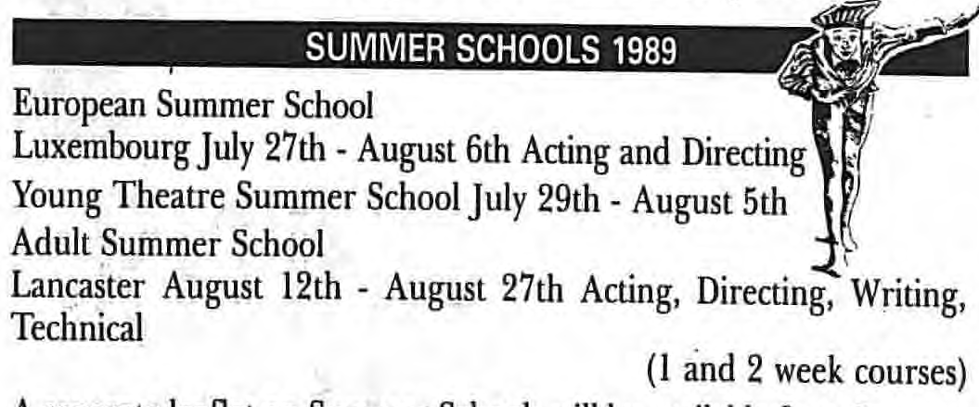

Slide 33
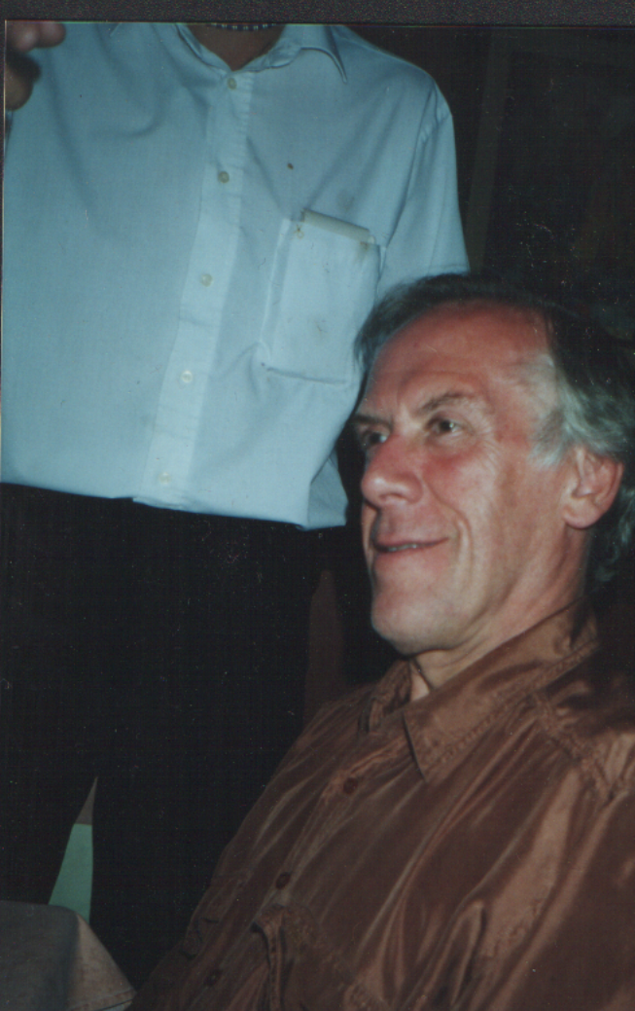
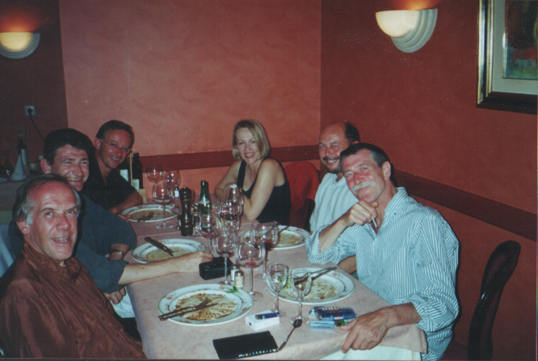
Chris Bearne

Slide 34
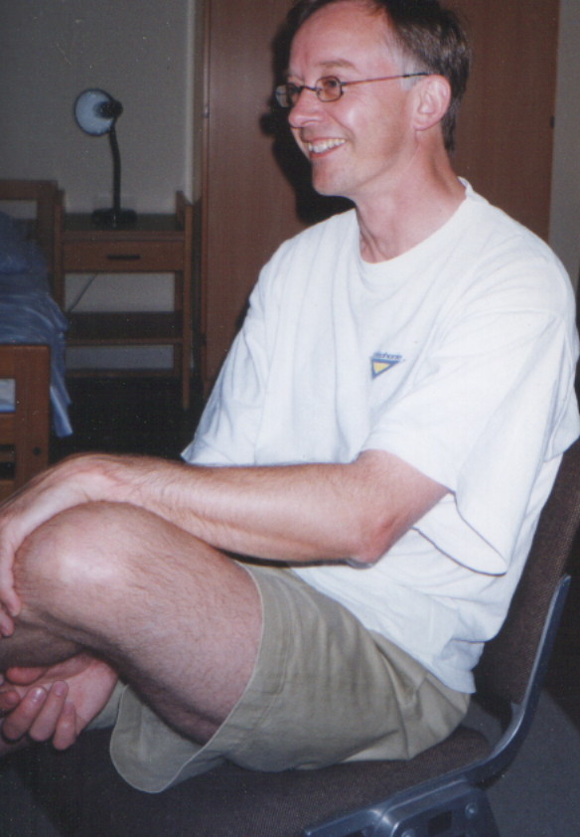
John Brigg
Janice Allgrove
Beverley Atkinson
Nola Dutton
Philip Dutton
Julie Frazer
Dave de Paeztron
Brian Parker

Slide 35
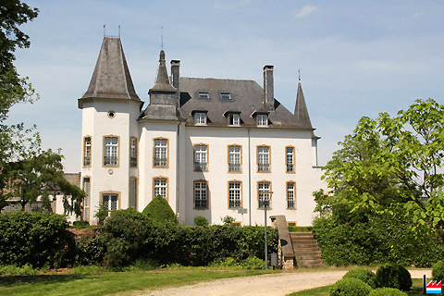
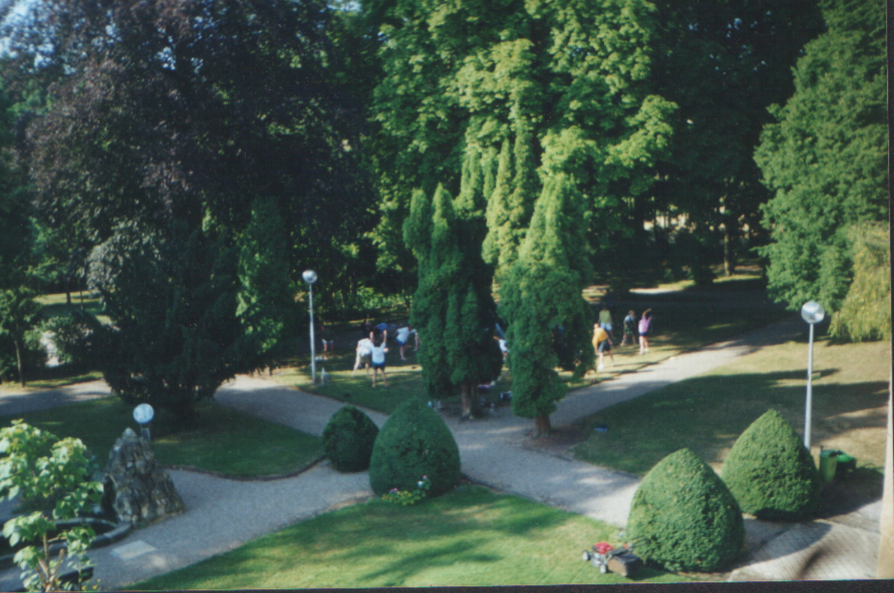
Chateau de Munsbach

Slide 36
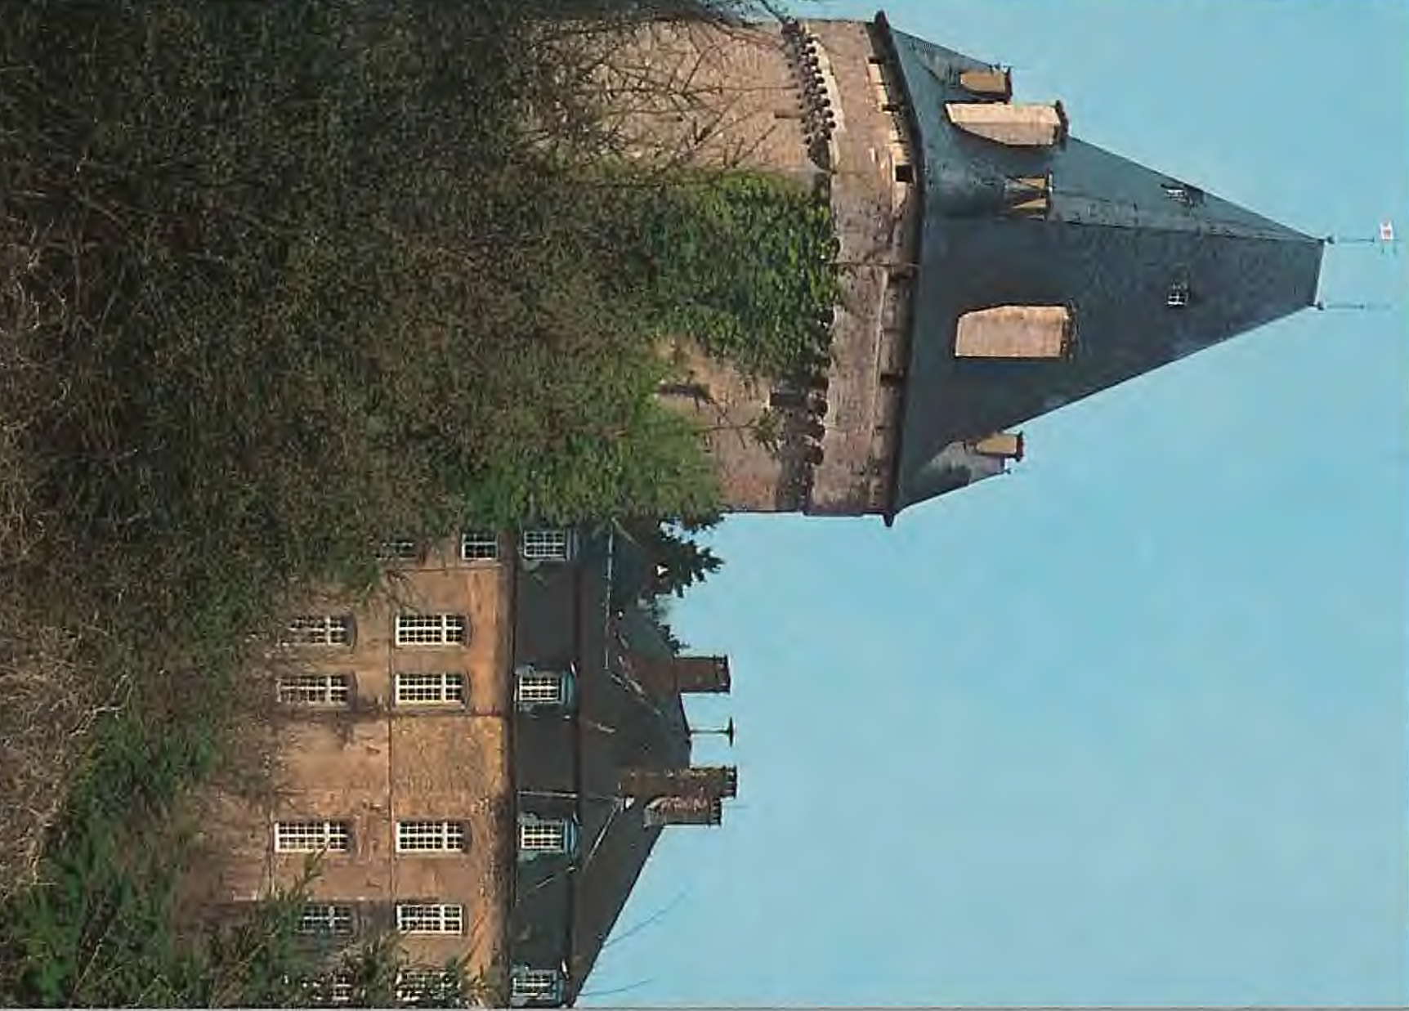
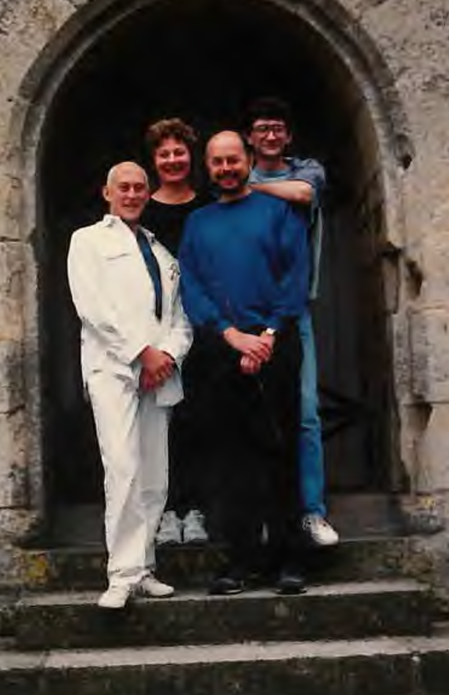
Hollenfells 1994

Slide 37
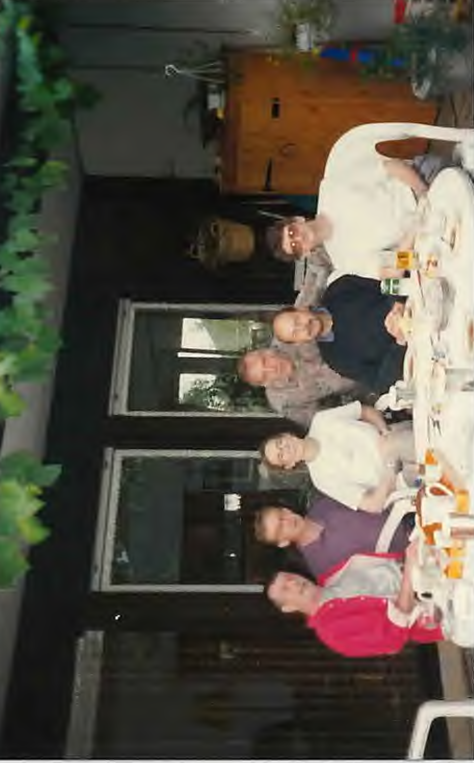
1996
The programme changes are complete.

Slide 38
1996
The programme changes are complete.
We are exhausted!

Slide 39
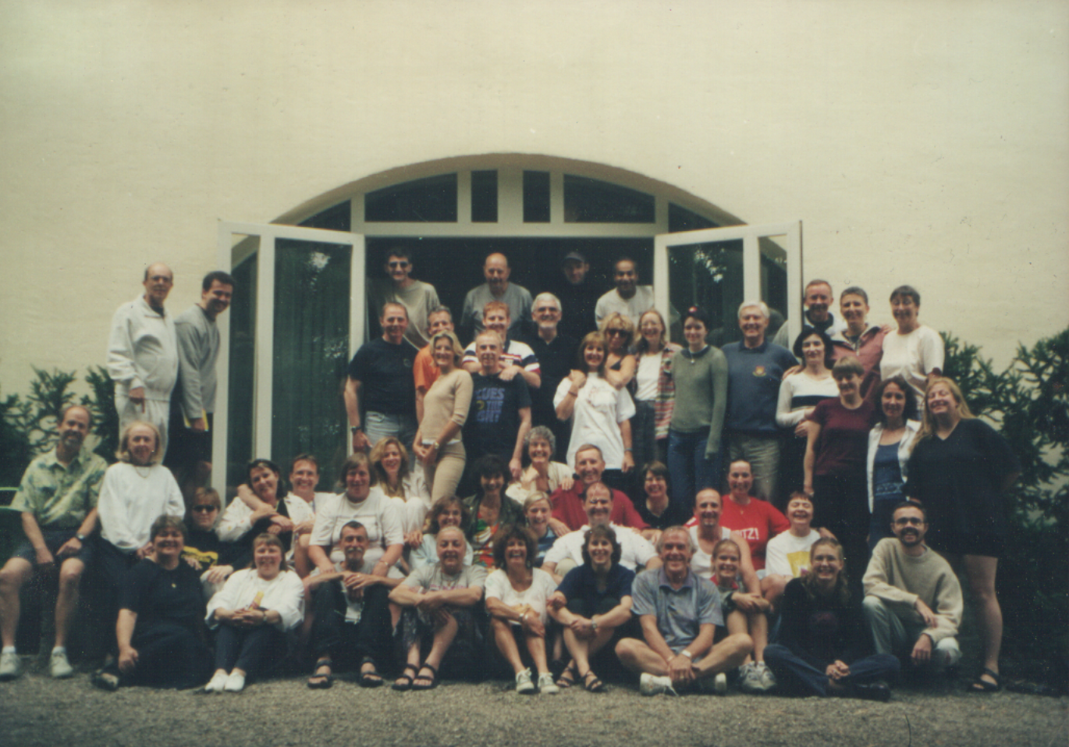
The Group Photo 2001

Slide 40
Graeme du Fresne
LEATSS Course Director
2004 -

Slide 41
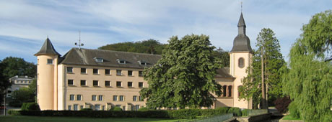
Clairefontaine

Slide 42
90th Year of Summer School
Here’s to 2025

